Slide 1

Homework 001
P
Say HELLO to the system~
Task 1: 2022/3/28 TUE. 23:59 DUE 繳交期限

Slide 2
Goal of hw1
G
Learn to write a console program
int main(int argc, char *argv[])
Learn to use system API
fork(), exec*()
open(), read(), write(), close(), exit() …
Use Makefile to provide several service
compile, clean & test tasks
Execute a program (master.out) to fork() a child program(mmv.out) and add one new line on the head of input file …

Slide 3


Work flow of Task 1
CI
master.out
fork & exec
Print the PID of child
fork() & exec()
mmv.out
Read file
Write to file
Fork & execute a new process
Read a file & add one new line on the head of input file …
Write to another one (.tmp)
* you may use execlp or other family API

Slide 4
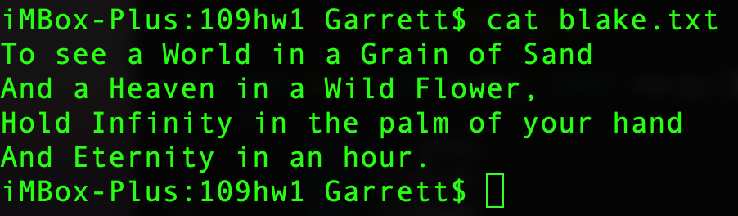
Task 1 – Makefile
G
Generate at least two c codes and a Makefile
Put the “blake.txt” into the same folder
Name of the folder “s123456_OShw1”

Slide 5
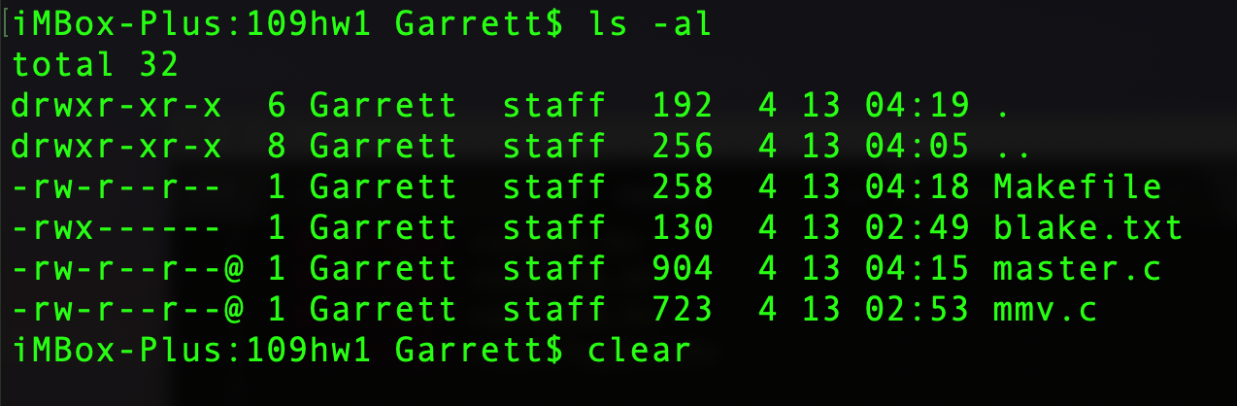
Task 1 – Makefile
G
Generate at least two c codes and a Makefile
Put the “blake.txt” into the same folder
Name of the folder “s123456_OShw1”
Then, write a Makefile to provide several services
compile, clean & test tasks

Slide 6
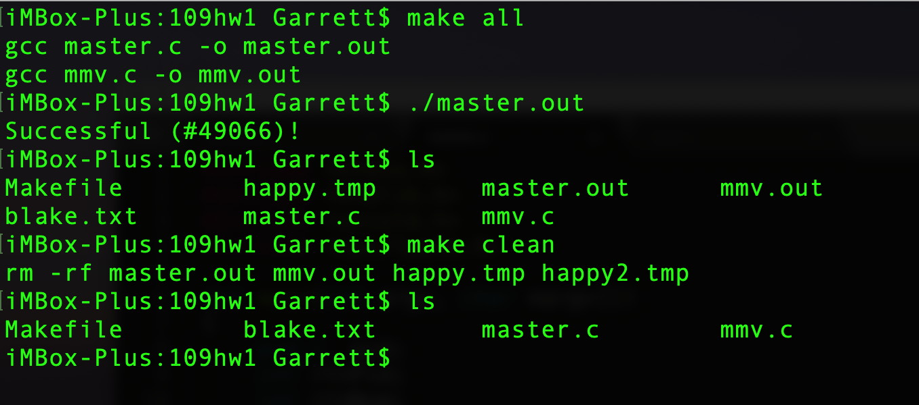
Task 1 – Makefile
G
make all --- compile all c code

Slide 7
Task 1 – Makefile
G
Make clean --- clean outputs/exec files
Delete all .out and .tmp files

Slide 8
Execute a test
G
./master.out --- execute a test
Generate a file “happy.tmp”
Note: #49066 is the pid of children process

Slide 9
Task 1 – The requirements
R
Allow TAs use "make all" to build your code.
Allow TAs use "make test" to test your program.
Allow TAs use "make clean" to delete all stuffs
(.out) is executable files.
(.tmp) is temporally text files generated by your program
Functions of your program
Copy context of one file to another one (target file)
Add a several new sentence in the target file
程式需要「可以編譯執行」助教才會批改

Slide 10
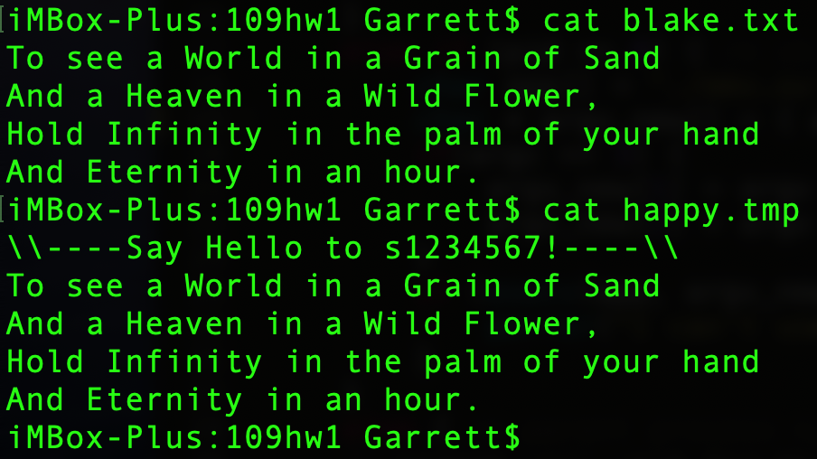
Task 2 – manipulate file
G
The file “happy.tmp” has been add a sentence on the head of the file
\\----Say Hello to s1234567!----\\

Slide 11
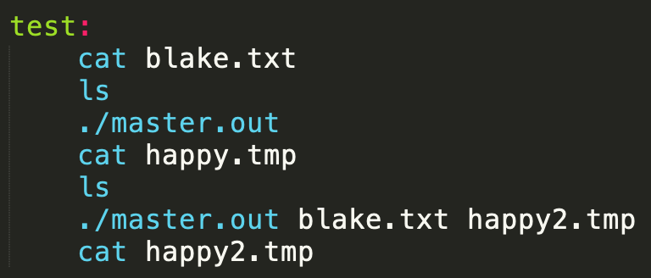
Task 3 – run a test
G
Make test --- run a test scripts
./master.out
= ./master.out blake.txt happy.tmp
./master.out A.txt B.tmp (BONUS)
It means we copy all sentences from file A.txt to B.tmp and add a new line

Slide 12
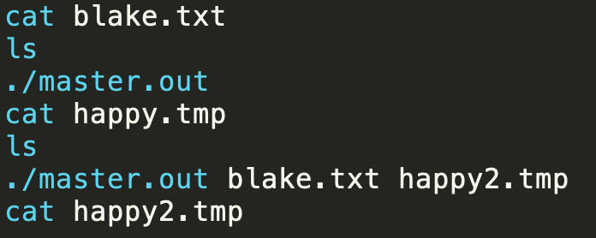
Task 3 – test & output
G
Makefile

Slide 13
The requirements
Allow TAs use "make all" to build your code.
Allow TAs use "make test" to test your program.
Allow TAs use "make clean" to delete all stuffs
(.o) object files.
(.out) executable files.
(.tmp) temporally text files generated by your program
Functions of your program
Copy context of one file to another one (target file)
Add a several new sentence in the target file
程式需要「可以編譯執行」助教才會批改

Slide 14
The requirements
R
R
Allow TAs use "make all" to build your code.
Allow TAs use "make test" to test your program.
Allow TAs use "make clean" to delete all stuffs
(.o) object files.
(.out) executable files.
(.tmp) temporally text files generated by your program
Functions of your program
Copy context of one file to another one (target file)
Add a several new sentence in the target file
程式需要「可以編譯執行」助教才會批改

Slide 15
Submit your homework 001
R
Please make sure we could use your makefile to build and test the project.
Put all stuff into the folder (s123456_OShw1)
replace s1234567 by your own student ID.
Please attach a slides(s1234567_hw1.pdf ) to explain what works you completed and how you completed them. Please also use this document if you have other things to tell your teaching assistant.
* This document(s1234567_hw1.pdf) must include a demo (snapshots) of your homework
Pack all the file into a folder named “s1234567_OShw1”
Zip it and Upload to Portal
任何格式不符、多上傳檔案或其他造成助教困擾的狀況一律扣10分

Slide 16
revisited
CI
master.out
fork & exec
Print the PID of child
fork() & exec()
mmv.out
Read file
Write to file
Fork & execute a new process
Read a file & add one new line on the head of input file …
Write to another one (.tmp) by mmv.out
* you may use execlp or other family API

Slide 17
Homework 002
P
Send a kind message
2022/4/9 FRI. 23:59 DUE 繳交期限

Slide 18
Goal of hw2
G
Learn to write a console program and pass information between them
int main(int argc, char *argv[])
execlp, execvp …
Learn to use system API
pipe, dup* …

Slide 19
Use pipe(1)
Pipe()
CI
master.out
fork & exec
Read file
Execute a program (master.out) to read a file into its memory
Create a pipe()

Slide 20
Use pipe(2)
CI
master.out
fork & exec
Read file
fork
& exec
pipe
mmv.out
*Additional information
may required.
Print your PID
Write to file
Fork & execute a new process
Read from stdin & add one new line on the head of input file …
Write to another one (.tmp)

Slide 21
Hw2 – run a test
G
Make test --- run a test scripts
./master.out
= ./master.out blake.txt happy.tmp
./master.out A.txt B.tmp (Required)
It means we copy all sentences from file A.txt to B.tmp and add a new line
程式的外觀行為跟之前都是一樣的～

Slide 22
The requirements
Allow TAs use "make all" to build your code.
Allow TAs use "make test" to test your program.
Allow TAs use "make clean" to delete all stuffs
(.o) object files.
(.out) executable files.
(.tmp) temporally text files generated by your program
Functions of your program
Copy context of one file to another one (target file)
Read file by "master.out” and pass them to the "mmv.out” with pipe().
Add a several new sentence in the target file by "mmv.out"
程式需要「可以編譯執行」助教才會批改

Slide 23
Submit your homework 002
R
Please make sure we could use your makefile to build and test the project.
Put all stuff into the folder (s123456_OShw2)
replace s1234567 by your own student ID.
Please attach a slides(s1234567_hw2.pdf ) to explain what works you completed and how you completed them. Please also use this document if you have other things to tell your teaching assistant.
* This document(s1234567_hw2.pdf) must include a demo (snapshots) of your homework
Pack all the file into a folder named “s1234567_OShw2”
Zip it and Upload to Portal
任何格式不符、多上傳檔案或其他造成助教困擾的狀況一律扣10分

